Slide 1
A Survey of Modern Artificial Intelligence
Kyle Xiao
Notes:
-Thank Audience
-What is this about?

Slide 2
About Me
CSE PhD Student at the University of Washington with interests in natural language processing
Collaborated with Microsoft Research on generative adversarial network (GAN) image reformulation
Recent grad from Georgia Tech; worked on symbolic reinforcement learning in the Entertainment Intelligence Lab
Interned in software, applied science, and finance roles

Slide 3
Overview
AI is a relatively broad concept
Encompasses many philosophies and approaches to “human intelligence”
Human intelligence as a whole is hard to define
Cognition? Language? Knowledge? Reasoning?
In general, researchers today break down AI into well-defined tasks.
e.g. in natural language processing (NLP), we have
Searching, translation, summarization, named-entity recognition, part of speech tagging, information retrieval, sentiment analysis, ...
Notes:
Not Monolithic

Slide 4
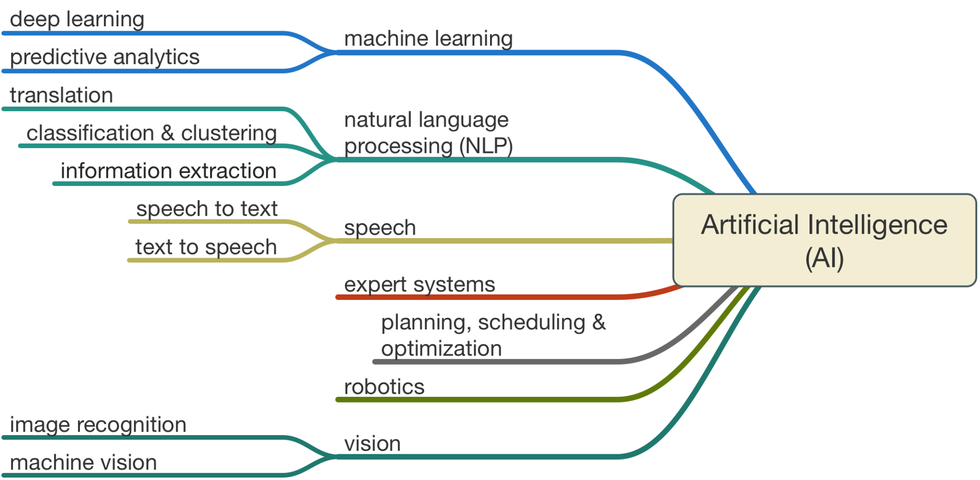

Slide 5
Different Approaches
Statistical techniques
OLS, HMM, SVM, Decision Trees, Sampling, Bayesian Methods
Algorithmic techniques
Graph Search, Spectral Methods, Dimensionality Reduction
Expert systems
Rule-based Systems, Knowledge Chaining, Custom Filters
Gradient Approaches
Only possible due to explosion of data available
Neural Nets: MLPs, CNNs, LSTMs, etc
Domain-specific Applications & Advancements
Transformers, Off-Policy RL, GANs, Knowledge Graphs
Notes:
CFG Production Rule

Slide 6
Philosophies
Are compute-heavy algorithms AI?
Most modern approaches use many parameters and expensive computation to achieve SOTA
Is this comparable to human cognition? Are tasks beyond human intelligence AI?
Criterion for Strong-AI
Is Turing test necessary and sufficient?
How to represent knowledge?
Symbolic vs Latent representations
Is AI compression?
Information theory view: “comprehension is compression”
Why not use infinite N-Gram for every NLP task?
Explainability
How important is interpretability in models? When should humans intervene? How to control data bias?
Notes:
textual, visual, and auditory - Loebner test
Minimum description length (MDL) principle

Slide 7
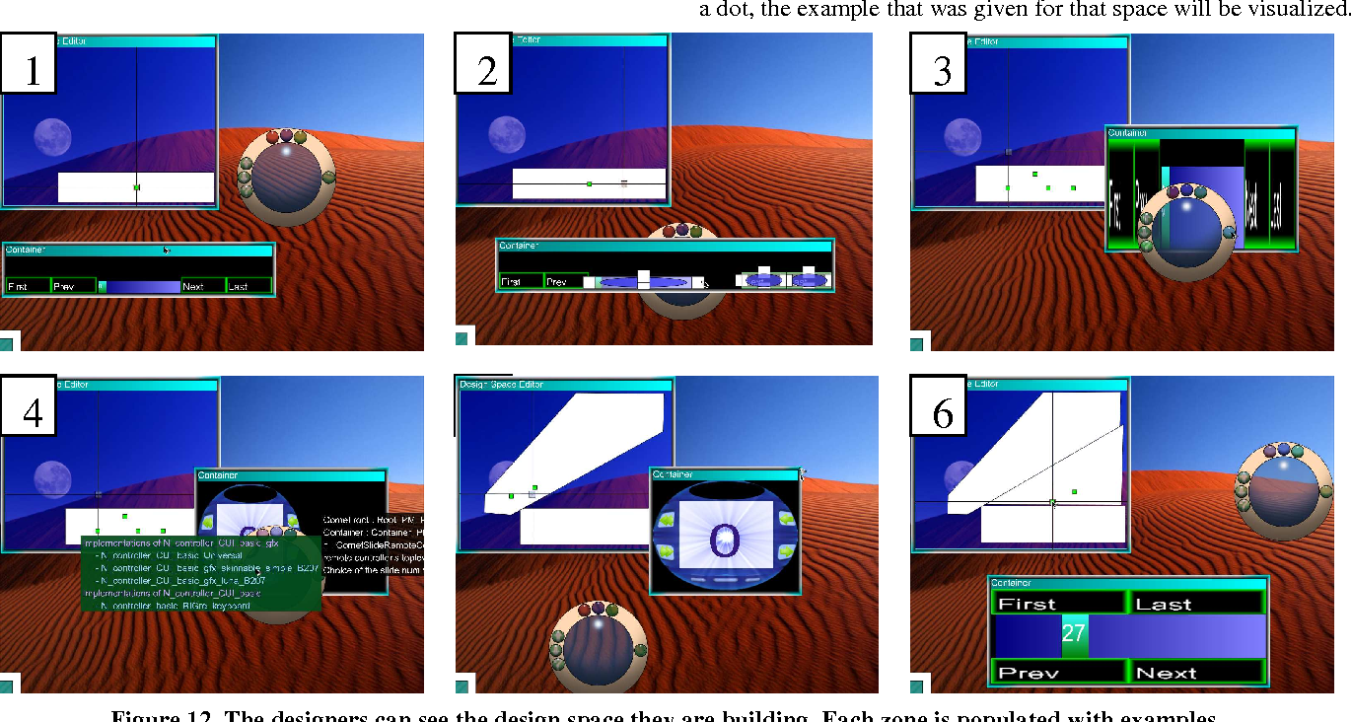
Human Computer Interaction (HCI) Frameworks
How to define AI interaction with humans?
Fully Autonomous
Mixed-initiative
Co-creativity
How to define team utility?
Are high-accuracy models necessarily the best?
Understanding error boundaries and trust
Communicate failure cases
Surprisingly, people trust AI models more than they should
Adaptable interfaces

Slide 8
Recent Breakthroughs
Attention Is All You Need
Transformers
BERT, BART, ELMo, GPT-2, GPT-3, etc.
Network Architecture Search / AutoML
Metalearning
Off-Policy RL
Policy Gradients, Actor-Critic, Soft Actor Critic (SAC)
Knowledge Graphs,
Graph Attention (GAT)
Conditional and Unconditional GANs
Pix2Pix, StyleGAN
Notes:
Examples
Entropy Regularization

Slide 9
Natural Language Processing
Reading Comprehension
https://demo.allennlp.org/reading-comprehension/bidaf-elmo
Sentiment Analysis
https://demo.allennlp.org/sentiment-analysis/glove-sentiment-analysis
Textual Entailment
https://demo.allennlp.org/textual-entailment/elmo-snli
Prompt Engineering (Trained on Masked Language Modeling)
https://www.gwern.net/GPT-3

Slide 10
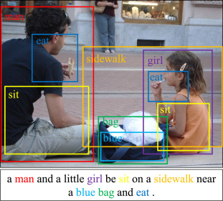
Computer Vision
Object Detection, Segmentation, and Classification
https://www.youtube.com/watch?v=h08N0HX16l8
Conditional Image Generation
https://affinelayer.com/pixsrv/
Unconditional Image Generation
https://thispersondoesnotexist.com/
Image-Sentence Retrieval
Notes:
DeepFakes

Slide 11
Speech
Speech to Text
CNN-RNN-CTC method
Voice Assistants
Speech Synthesis / Text to Speech
WaveNet/Tacotron - https://google.github.io/tacotron/publications/tacotron2/
Notes:
Previously HMM methods were king

Slide 12
Reinforcement Learning
Multi-Armed Bandits
Model-Based RL
AlphaGo, AlphaZero,
Model-Free RL
Atari DQN Breakout
https://www.youtube.com/watch?v=V1eYniJ0Rnk
Transfer & MultiTask RL
Meta-RL
SNAIL
More papers
https://spinningup.openai.com/en/latest/spinningup/keypapers.html
Notes:
Sample Efficiency

Slide 13
Expert Systems / Symbolic Knowledge
Rule-based systems
http://www.exsys.com/demomain.html
Knowledge Graphs
http://demo.staple-api.org/

Slide 14
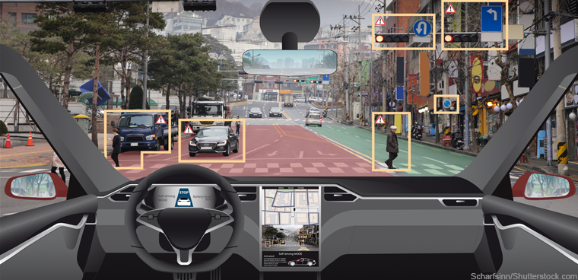
Applications - Engineering
Agriculture
Crop and Soil Monitoring, Agricultural Robots, and Predictive Analytics (Microsoft AI for Earth)
Manufacturing
Digital Spectrometry by IdeaCuria Inc.
Transportation
Self-driving cars, Flight Simulations
Big Data
Information compression
Automation

Slide 15
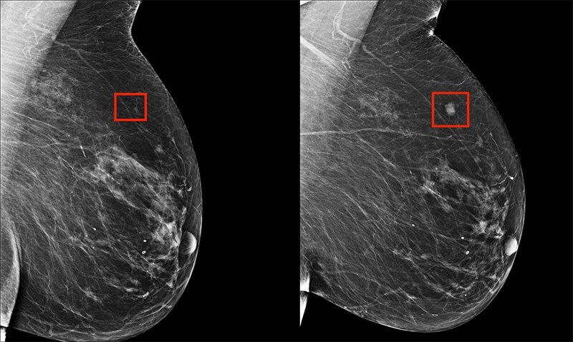
Applications - Medicine
Entire conferences dedicated to medical AI (e.g. MIDL)
Medical Imaging
Detecting tumors, blood clots, lesions, etc.
Mining Medical Records
Drug Creation
Designing treatment plans
IBM Watson

Slide 16
Applications - Finance
Anomaly/Fraud detection
Kasisto, Moneystream
Algorithmic trading
HFT, Market Making
Underwriting/Credit Risk
Upstart
Research in explainability
Risk Modeling
Automated Audits

